Slide 1
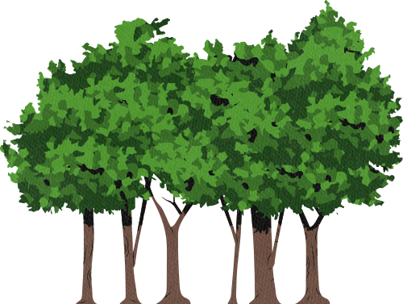


DRIVERS OF BIODIVERSITY CRISIS
CUSUMANO JULIA, ESTAÑOL CARRIÓN CLARA, KADLEC LUKÁŠ, MALIK PARV
FUNDAMENTALS OF ECOLOGY

Slide 2
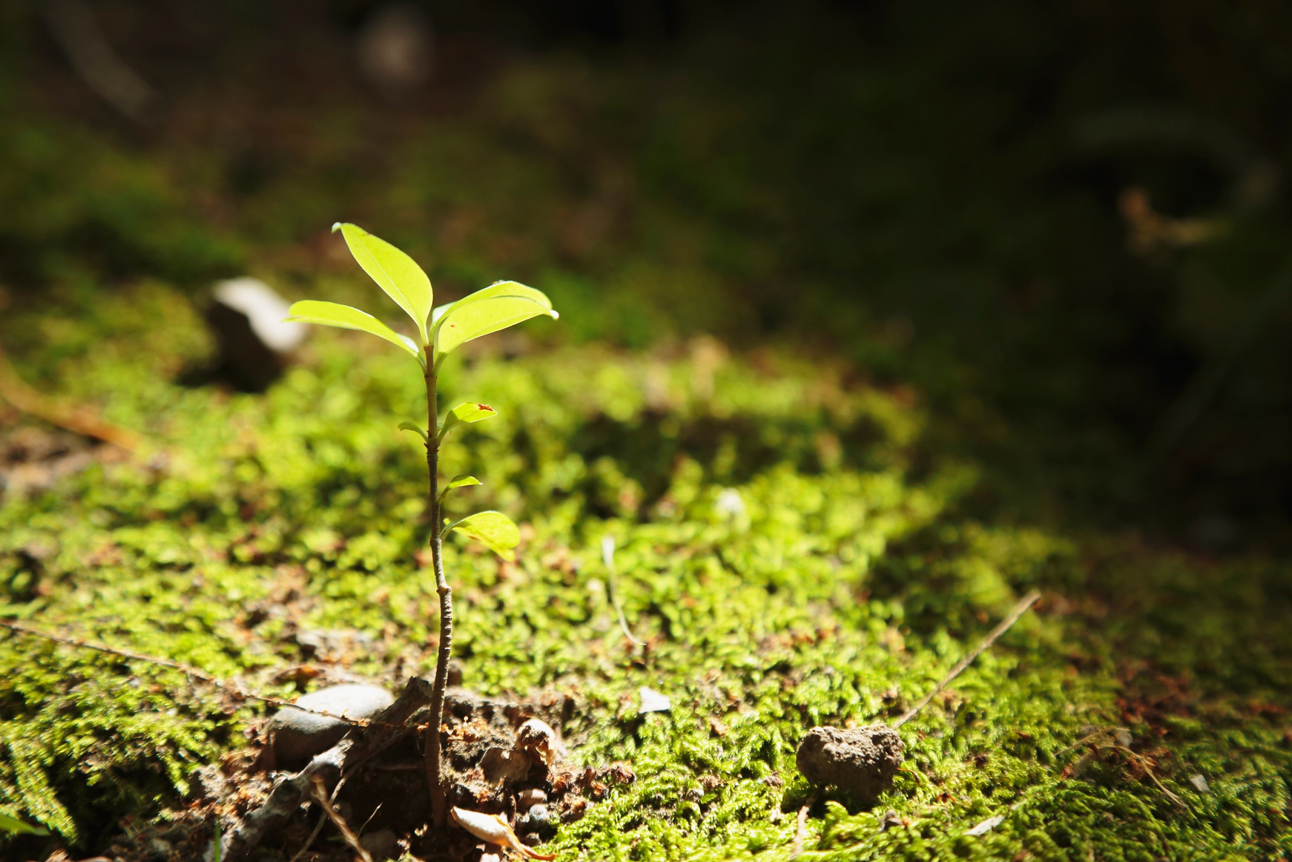
INTRODUCTION
Serious biodiversity crisis
Humans
The direct drivers of recent global anthropogenic biodiversity loss (Jaureguiberry et al. 2022)
The biomass distribution on earth (Bar-On et al. 2018)
What are the main drivers of the current biodiversity crisis?

Slide 3
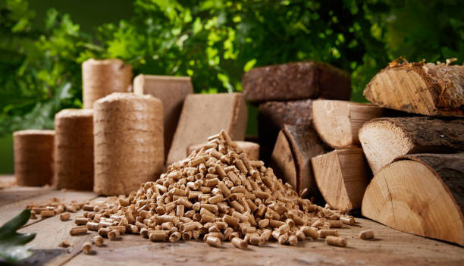
IN BRIEF...
Holistic analysis = a starting map to orient researchers in crisis areas
HOWEVER...holistic approaches can create a grey area ⟶ reductionist, problems with biases in metanalysis, require significant researcher triangulation.
The distribution of biomass can provide insight into potential short-term or long-term solutions.

Slide 4
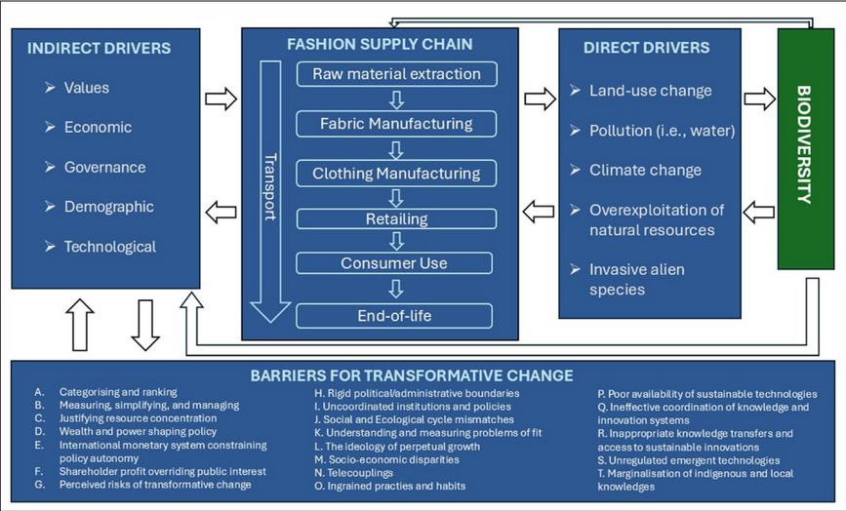
THE BIODIVERSITY CRISIS
DIRECT FACTORS
INDIRECT FACTORS
BIODIVERSITY CRISIS
Direct → Create immediate factors: over-exploitation, pollution, invasive species, climate change
VS
Indirect → Influence result through chains of various factors: economic systems, patterns of production, consumption, resource use...
Rapid, global decline of species, ecosystems and genetic diversity
Humans
Number and composition
(GREENSPOON ET AL.)

Slide 5
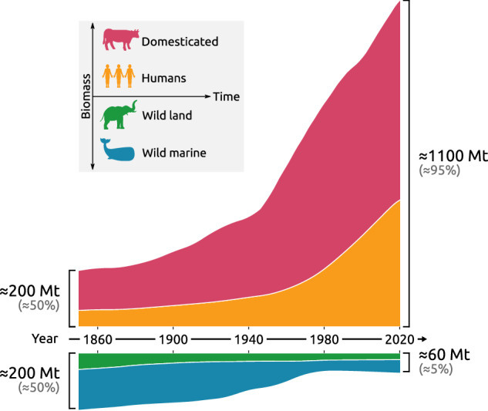
BIOMASS AND IT’S DISRUPTION
WHAT IS BIOMASS?
BIOMASS REALLOCATION
Total mass of living organisms in a given area
Measured in gigatons of carbon (Gt C) for global studies
Human activities reshape biomass distribution
Can be calculated by percentage.
To help the biodiversity crisis ⟶ we must redistribute
Today, biomass is very concentrated in our livestock.
Can also be in reallocating the use of land (for example, to promote more carbon sequestration).
(GREENSPOON ET AL.)

Slide 6
DEEP DIVE VS AI
Deep Dive led us to find that the papers do not define their key terms while AI skipped it over.
Similarly AI did not really provide us with accurate overview sometimes.
It also gleamed over some key details when giving us overviews, such as the methodology, its drawbacks and how various factors relate and affect eachother which is really important to understanding the ideas and essence of the papers.
Not using AI gave us a better grasp of the papers.

Slide 7
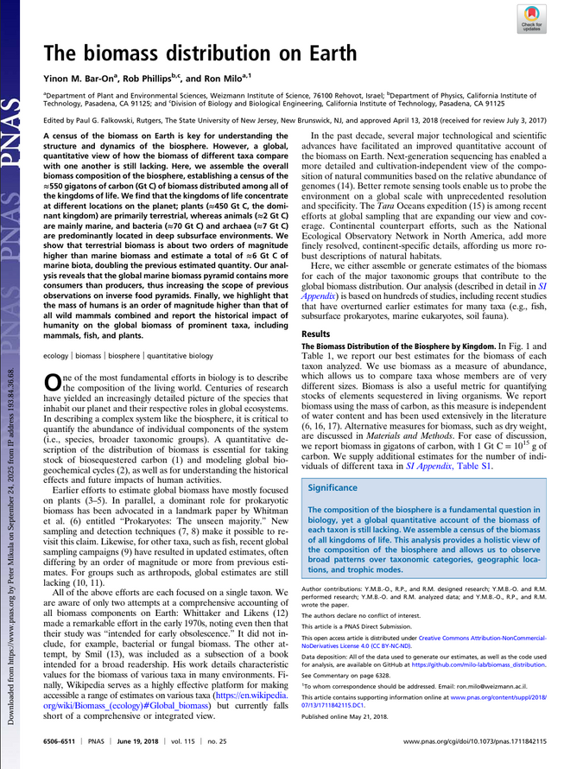
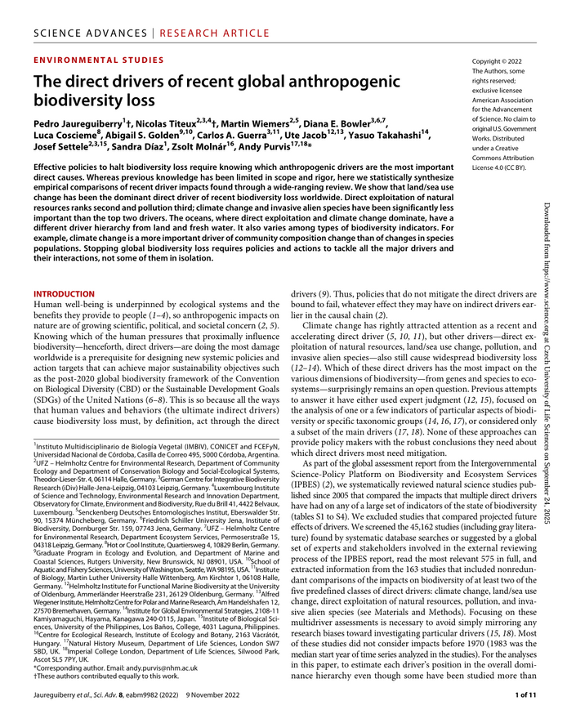
COMPARISON OF GIVEN STUDIES
THE BIOMASS DISTRIBUTION ON EARTH
(BAR-ON ET AL. 2018)
THE DIRECT DRIVERS OF RECENT GLOBAL ANTHROPOGENIC BIODIVERSITY LOSS
(JAUREGUIBERRY ET AL. 2022)
descriptive census of current global biomass.
? → What is the total biomass of life on Earth and how is it distributed?
Combines hundreds of datasets to estimate global carbon biomass.
analytical comparison of human-induced pressures
? → Which human-driven factors are the strongest causes of biodiversity loss?
Extracts pairwise dominance of five major drivers from 163 studies (more than 45000 screened)

Slide 8
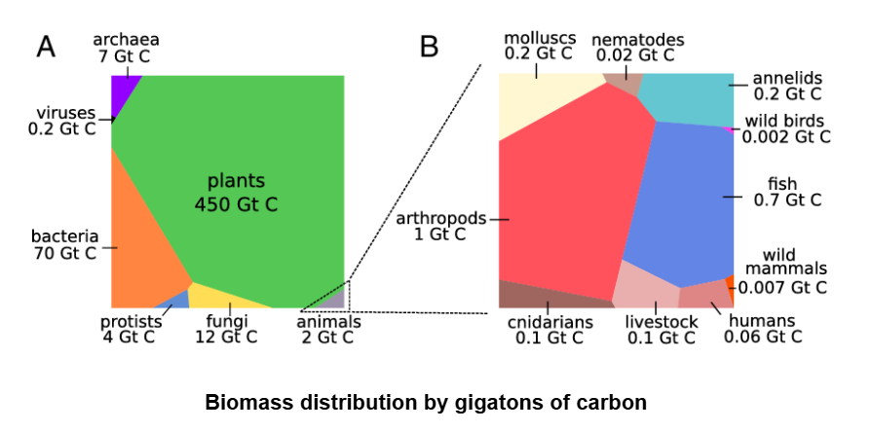
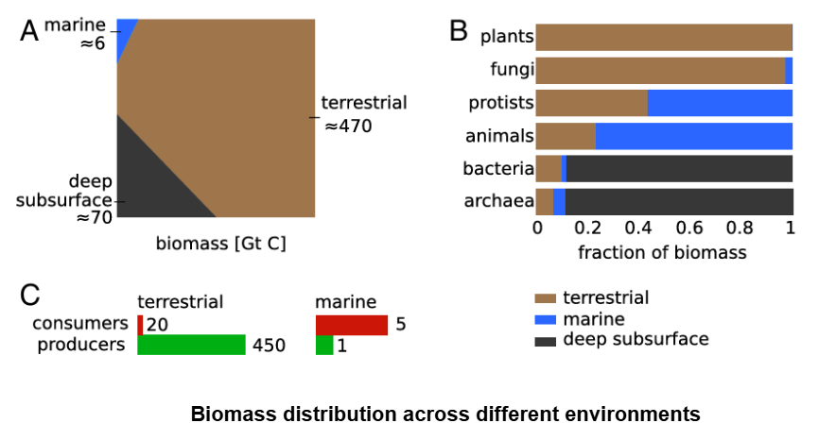
KEY FINDINGS
THE BIOMASS DISTRIBUTION ON EARTH
(BAR-ON ET AL. 2018)
Biomass is extremely uneven
Wild animals now form only a tiny fraction of Earth’s biomass
Human activity has:
Reduced wild mammal biomass
Halved global plant biomass since preindustrial times
Replaced wild animals with livestock and humans
Humans and livestock outweigh all vertebrates combined, with the exception of fish.

Slide 9
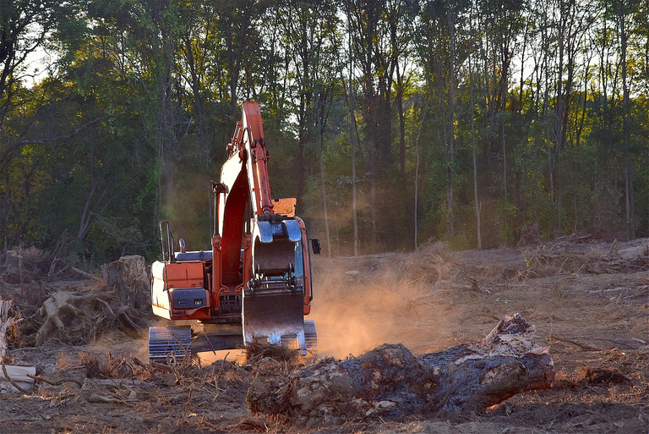
KEY FINDINGS
THE DIRECT DRIVERS OF RECENT GLOBAL ANTHROPOGENIC BIODIVERSITY LOSS
(JAUREGUIBERRY ET AL. 2022)
Direct drivers
Land/sea use change
dominant on land & fresh water
agriculture, deforestation, urbanization
Direct exploitation
dominant in oceans
fishing, hunting, logging, wildlife trade
Pollution
Climate change
Invasive species
Indirect drivers
Demographic growth
more land and biomass taken by humans
Economic development & consumption
agriculture, industrial fishing, resource extraction
Technological systems
enabling large-scale habitat alteration
Societal values & governance
determining land-use priorities

Slide 10
DEFINING THE TERMS
LAND/SEA USE CHANGE
CLIMATE CHANGE
INVASIVE ALIEN SPECIES
the process by which human activities transform both terrestrial and marine environments over time, causing alterations in how land and water are utilized for activities like agriculture, urbanization, and resource extraction.
the long-term shift in average weather patterns and temperatures, which can be identified by changes in the mean and/or variability of its properties that persist for decades or longer
an organism introduced by human activity outside its natural range that then becomes established and spreads, causing harm to the environment, economy, or human well-being
POLLUTION
DIRECT EXPLOITATION
the introduction of contaminants into the environment that cause harm or undesirable effects
the extractive use of living organisms by humans for various purposes, such as food, materials, and trade

Slide 11
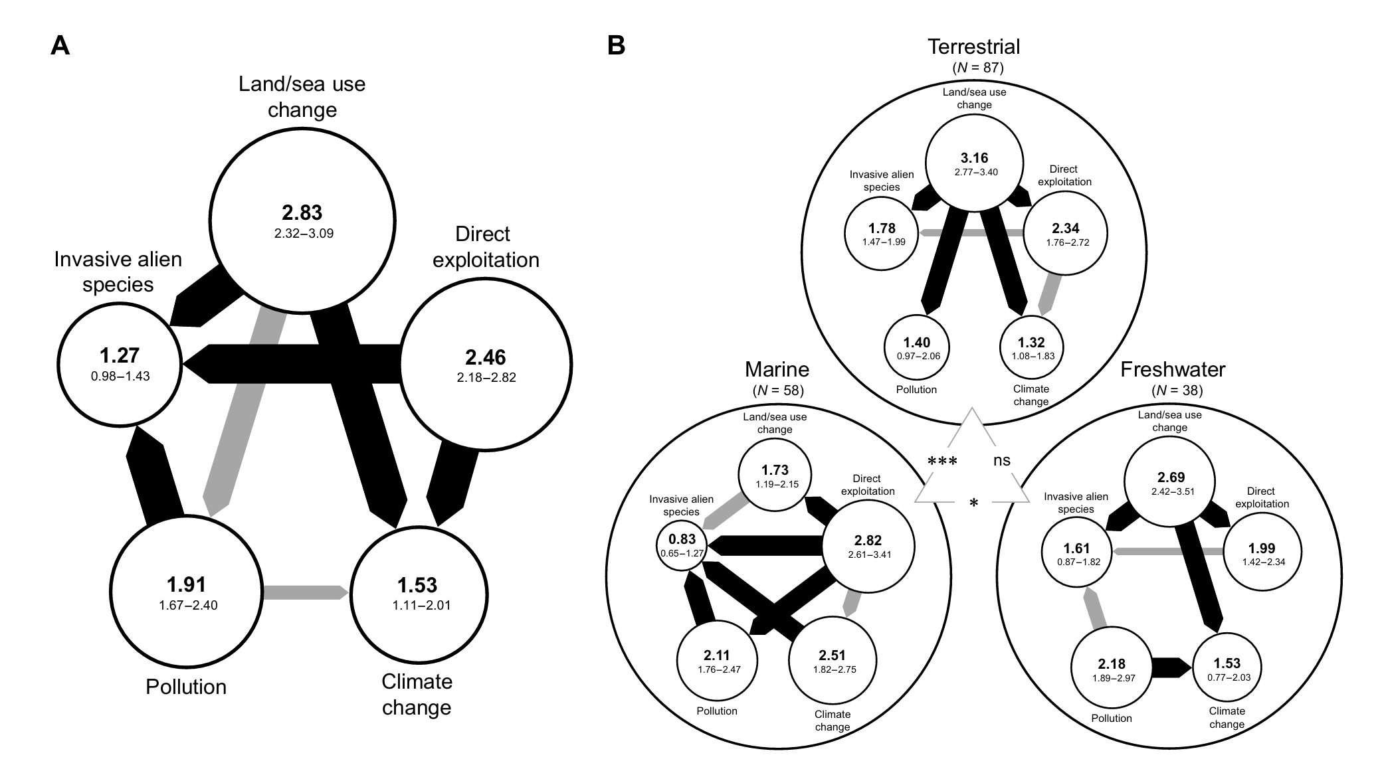

Slide 12
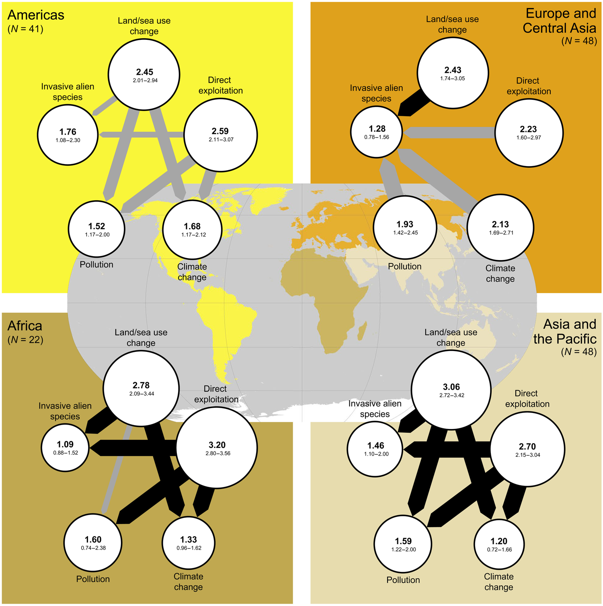
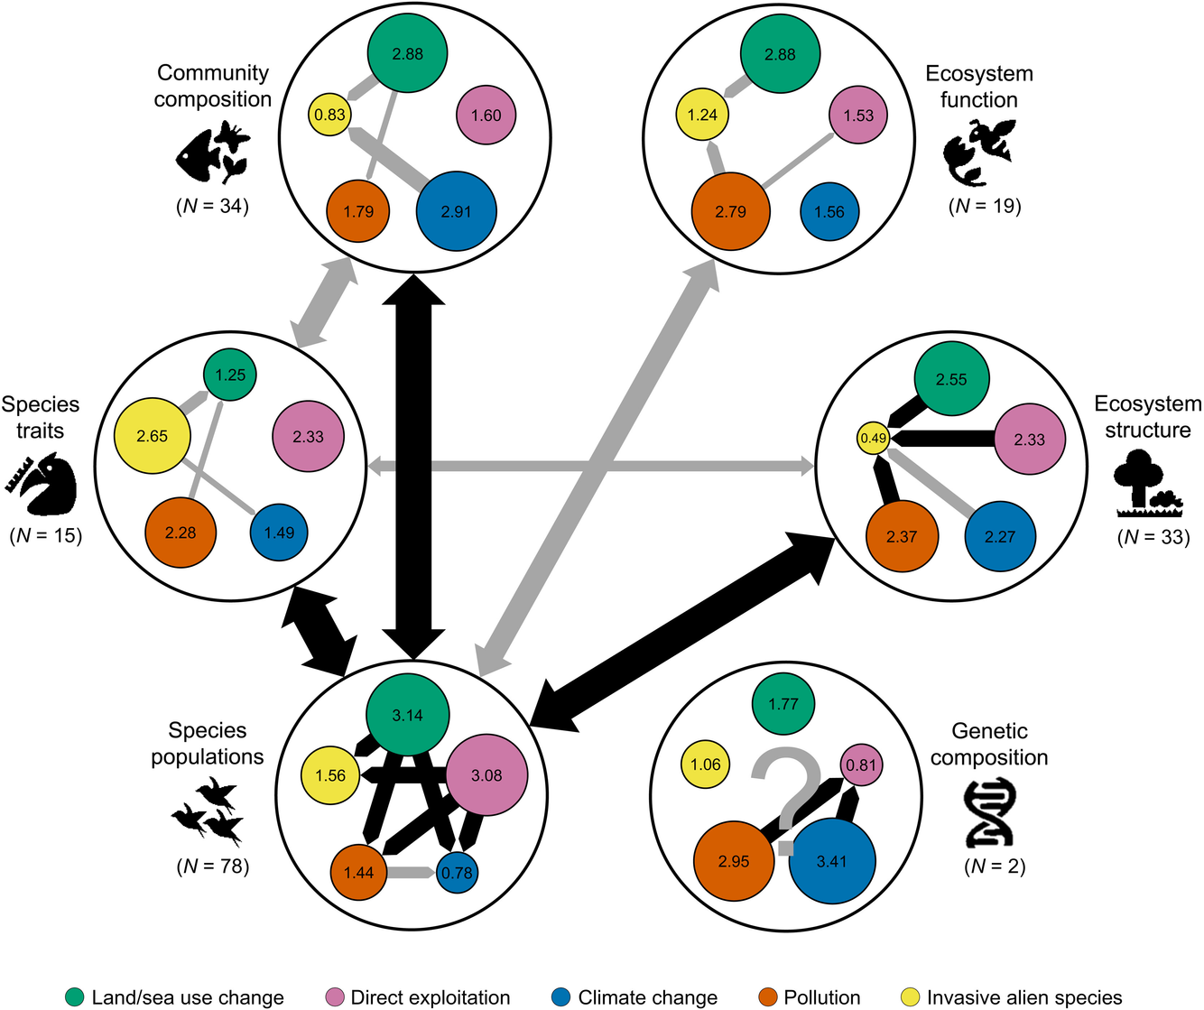
HOW FACTORS AFFECT EACHOTHER

Slide 13
HOW THESE STUDIES COMPLEMENT EACH OTHER
THE BIOMASS DISTRIBUTION ON EARTH
(BAR-ON ET AL. 2018)
THE DIRECT DRIVERS OF BIODIVERSITY LOSS
(JAUREGUIBERRY ET AL. 2022)
The historical depletion of many groups (wild mammals, plants).
describes the consequences
massive reductions in wild biomass
Why this depletion occurred and which human activities are mainly responsible.
identifies the causes
land-use change, exploitation, pollution, etc.
Farmland has replaced natural habitats → land-use change
Human consumption and exploitation reduce wild fish biomass → direct exploitation
together these drivers create human/livestock dominance in biomass.

Slide 14
CONCLUSION
THE FUTURE IS IN OUR HANDS

Slide 15
WHO DID WHAT?
JULIA + CLARA
LUKÁŠ + PARV
Introduction, briefing, and explanation of terminology involving the biodiversity crisis.
Comparison and analysis of papers, deep dive vs AI and terms definition.

Slide 16
CITATIONS
“EU Policies Addressing Indirect Drivers of Biodiversity Loss | Knowledge for Policy.” Europa.eu, 2023, knowledge4policy.ec.europa.eu/biodiversity/eu-policies-addressing-indirect-drivers-biodiversity-loss_en. Accessed 4 Dec. 2025.
Gall, Sarah S., et al. “Strategic Land Reallocation Enhances Carbon Sequestration and Biodiversity Protection without Compromising Agricultural Productivity in Great Britain.” Communications Earth & Environment, vol. 6, no. 1, Nature Portfolio, Sept. 2025, https://doi.org/10.1038/s43247-025-02728-w. Accessed 27 Oct. 2025.
Greenspoon, Lior, et al. “The Global Biomass of Mammals since 1850.” Nature Communications, vol. 16, no. 1, Springer Science and Business Media LLC, Oct. 2025, https://doi.org/10.1038/s41467-025-63888-z. Accessed 2 Nov. 2025.
Ha, K. Oanh. “Amazon Packages Burn in India, Last Stop in Broken Recycling System.” Bloomberg.com, 27 Dec. 2022, www.bloomberg.com/features/2022-india-plastic-recycling-pollution/.
IPBES. “Summary for Policymakers of the Global Assessment Report on Biodiversity and Ecosystem Services.” Zenodo (CERN European Organization for Nuclear Research), vol. 1, CERN European Organization for Nuclear Research, Nov. 2019, https://doi.org/10.5281/zenodo.3553579.
Mahajan, Alisha, and Kakali Majumdar. “Toxic Trade and Environmental Stringency: Exploring the Impact on Economic Growth in the G20.” Journal of Cleaner Production, vol. 422, Elsevier BV, Oct. 2023, pp. 138516–16, https://doi.org/10.1016/j.jclepro.2023.138516. Accessed 11 Apr. 2024.
Navarro-Gambín, Pedro, et al. “Paving the Ground for Biodiversity-Positive Transformative Change in Fashion: An Exploration of Drivers of Biodiversity Loss and Barriers to Transformative Change in the Textile, Apparel, and Fashion Sector.” International Journal of the Commons, vol. 19, no. 1, Ubiquity Press, Ltd., Aug. 2025, https://doi.org/10.5334/ijc.1458. Accessed 20 Oct. 2025.
Rosenberg, Yuval, et al. “Human Biomass Movement Exceeds the Biomass Movement of All Land Animals Combined.” Nature Ecology & Evolution, Springer Science and Business Media LLC, Oct. 2025, https://doi.org/10.1038/s41559-025-02863-9. Accessed 5 Nov. 2025.
Rowlands, Mark. “The Biomass Reallocation Program.” Oxford Academic, June 2021, pp. 172–88, https://doi.org/10.1093/oso/9780197541890.003.0009. Accessed 4 Dec. 2025.
“The Devastating Impact of Humans on Biodiversity.” Ieu.uzh.ch, 26 Mar. 2025, www.ieu.uzh.ch/en/news/2025/20250326.html. Accessed 4 Dec. 2025.
“Trade in Waste by Type of Material and Partner.” Doi.org, 2025, doi.org/10.2908/ENV_WASTRDMP. Accessed 13 Nov. 2025.
Waldron, Anthony, et al. Protecting 30% of the Planet for Nature: Costs, Benefits and Economic Implications Working Paper Analysing the Economic Implications of the Proposed 30% Target for Areal Protection in the Draft Post-2020 Global Biodiversity Framework. pure.iiasa.ac.at/id/eprint/16560/1/Waldron_Report_FINAL_sml.pdf.
World Health Organization. “Biodiversity.” World Health Organization, 18 Feb. 2025, www.who.int/news-room/fact-sheets/detail/biodiversity.

Slide 17
THANK YOU
FOR ATTENTION

